Slide 1
Thesis: Mathematics and software for a system that hides faces and advertising on video in real-time (Створення математичного та програмного забезпечення для системи приховання обличчя та реклами у реальному часі).
Студент: Тищенко Богдан
Керівник: доцент Олефір Олександр

Slide 2
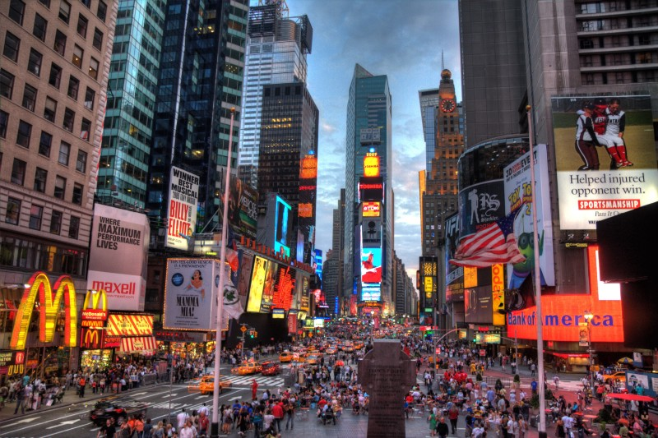
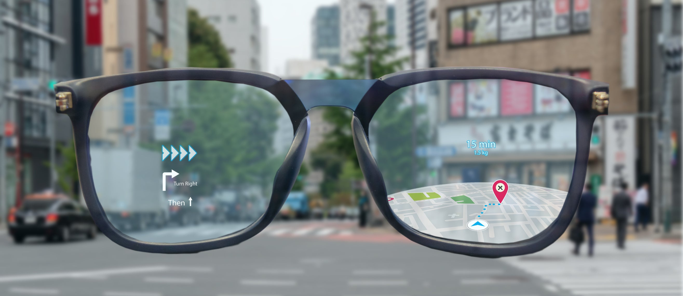
Motivation
Visual noise in big cities.
Augmented Reality glasses technology

Slide 3
Goal description
Functional requirements:
Read data from a webcam of a user.
Detect faces.
Detect advertising.
Visualize graphically as a live video stream with blurred faces and ads.
Non-functional requirements
(GPU: Nvidia GeForce GTX 1650 or better):
24+ fps
50ms delay
Accurate detections

Slide 4
Models comparison
Advertising detection
Face detection
Model | fps | mAP | Segmentation
YOLACT | 17.2 | 26.8 | Yes
Mask R-CNN | 9 | 35.7 | Yes
YOLO | 27-92 | 52-63 (VOC dataset) | No
YOLOv3 | 14-28 | 51.5-57.9 | No
YOLOv5 | 16-62 | 43-54 | No
Model | Fps | Accuracy
MTCNN | 30 | Very-High
YOLO | 16-62 | High
Viola-Jones | 15+ | Low

Slide 5
Models ranked
YOLO (fast, medium accuracy)
MTCNN (medium speed, high accuracy)
YOLACT (medium speed, high accuracy)
M-RCNN (slow, high accuracy)
Viola-Jones (low accuracy)

Slide 6
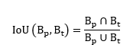
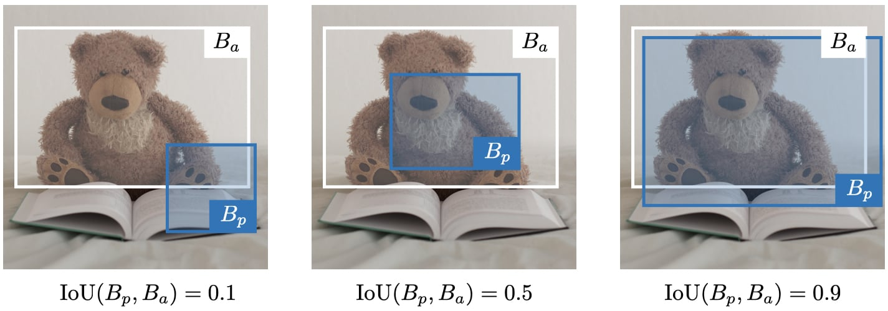
Intersection Over Union (IoU)
Supplementary method
IoU(truth, pred) > 0.5 -> prediction is valid

Slide 7
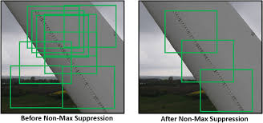
Non-max suppression (NMS)
Supplementary method
Algorithm:
Discard if confidence
While any left:
Output box with max confidence (B).
if IOU(B, box) > 0.5 -> discard box.

Slide 8
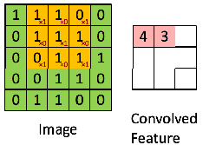
Convolutional layer
Filters = weights
F filters per layer

Slide 9
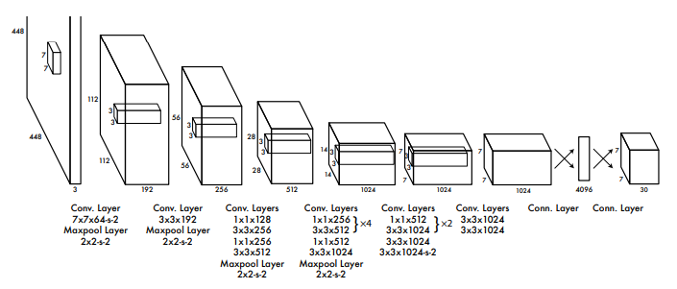
Classic YOLO CNN architecture
[Redmon, J., Divvala, S., Girshick, R., & Farhadi, A. You Only Look Once: Unified, Real-Time Object Detection]

Slide 10
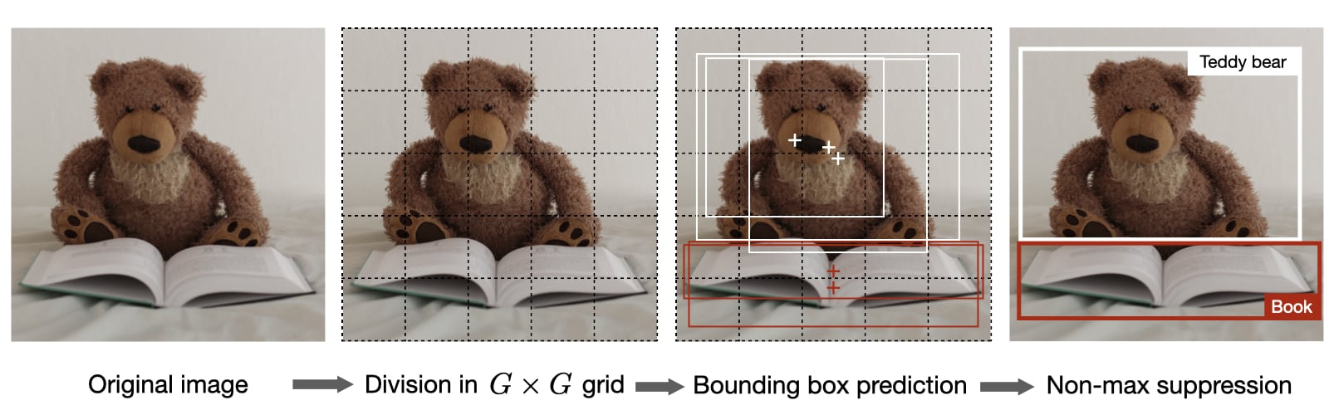
How does YOLO work
Output grid cell vector having 3 training classes

Slide 11
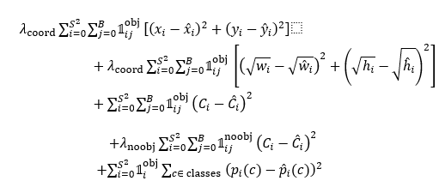
Loss function

Slide 12
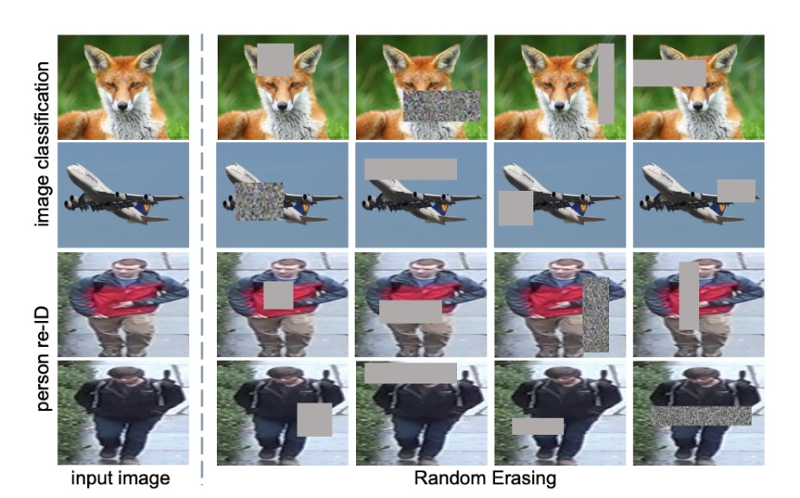
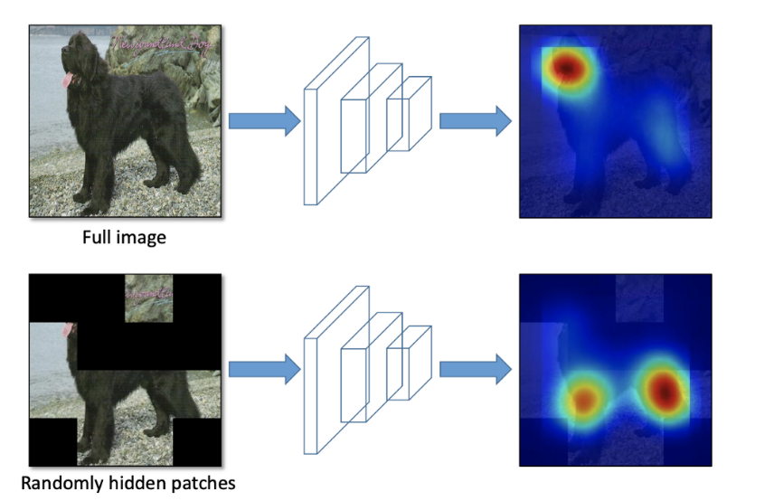
Dataset augmentation techniques
[Zhong, Z., Zheng, L., Kang, G., Li, S., & Yang, Y. (2020). Random Erasing Data Augmentation]
[Singh, K. K., & Lee, Y. J. (2017). Hide-and-Seek: Forcing a Network to be Meticulous for Weakly-Supervised Object and Action Localization]

Slide 13
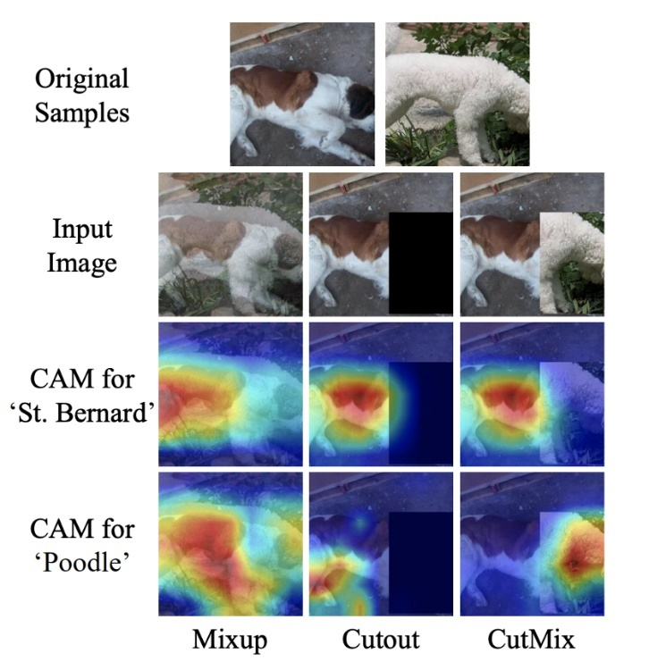
YOLO inspired augmentations
[Sangdoo Y., Dongyoon H., Seong J. O. (2019) CutMix: Regularization Strategy to Train Strong Classifiers with Localizable Features]

Slide 14
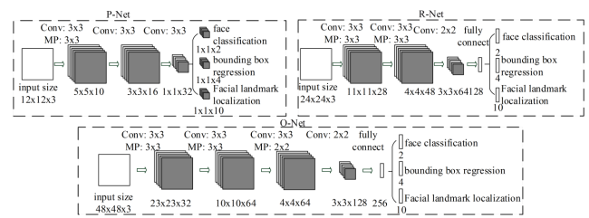
Multi task convolutional neural network (MTCNN)
[Zhang, K., Zhang, Z., Li, Z., & Qiao, Y. Joint Face Detection and Alignment using Multi-task Cascaded Convolutional Networks]

Slide 15
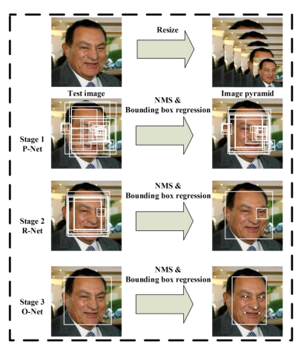
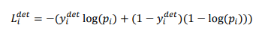
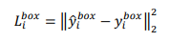
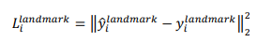
Loss functions
Classification loss (Proposal-Network)
Bounding Box Regression
Facial landmark localization

Slide 16
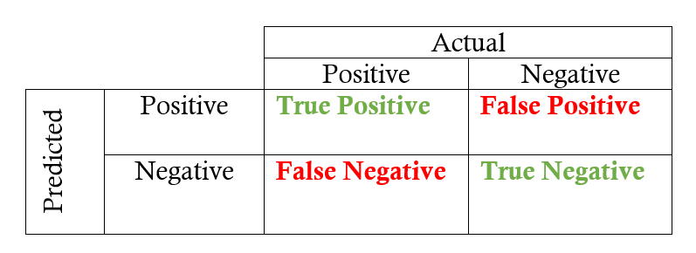
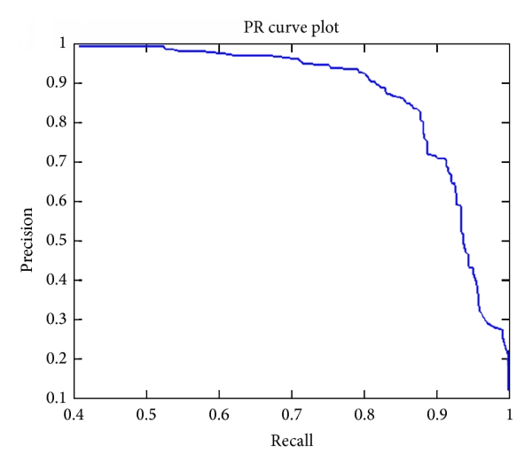
AP/mAP accuracy scores
$\text{Precision} =\frac{tp}{tp+fp}$
$AP=\int_{0}^{1}{}p\left(r\right)dr$
, n – number of classes

Slide 17
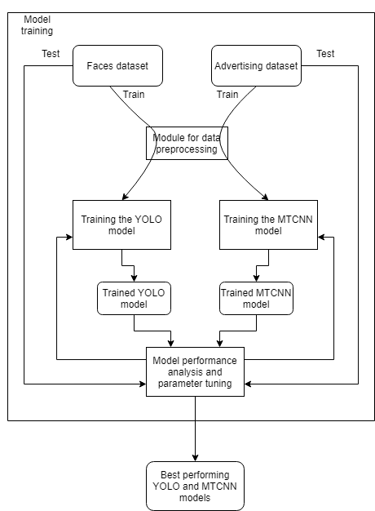
Model training architecture

Slide 18
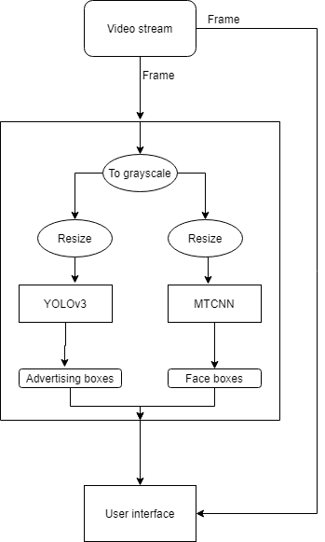
User application architecture

Slide 19
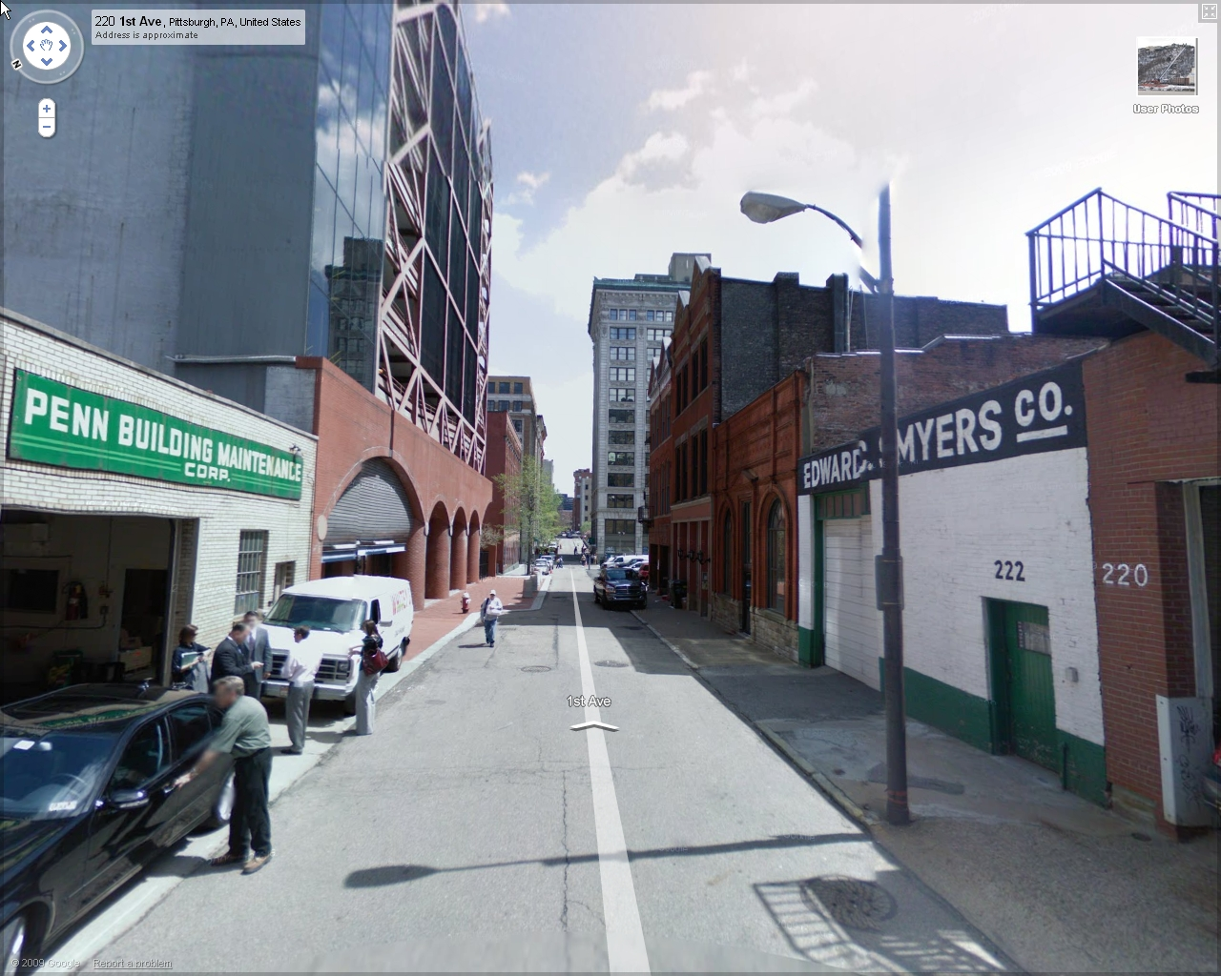
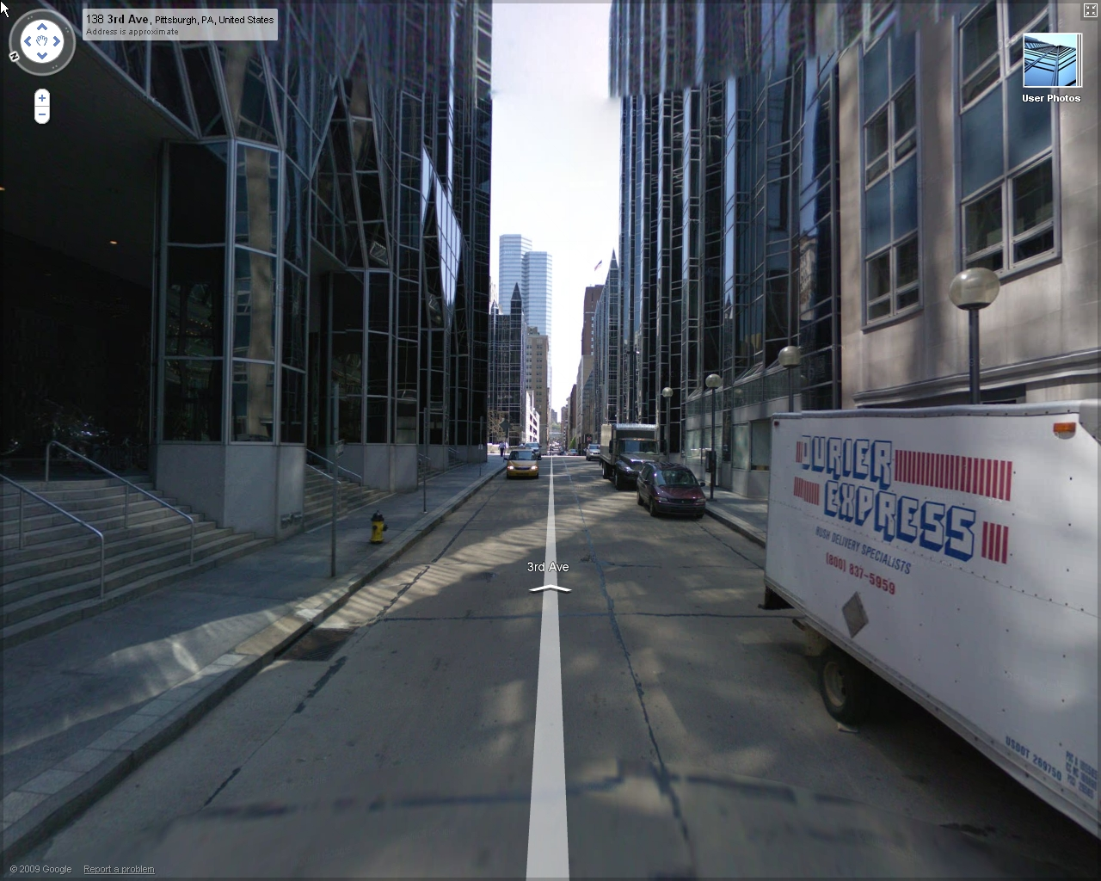
Advertising dataset
Google Street View screenshots.
Instance segmentation
Annotations – pentagons
Size:
6594 images
2043 contain objects

Slide 20
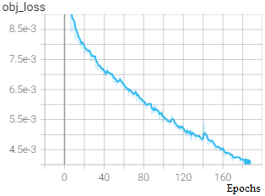
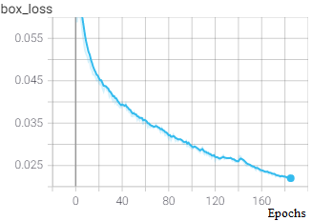
Loss during training. YOLO

Slide 21
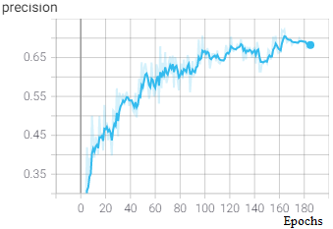
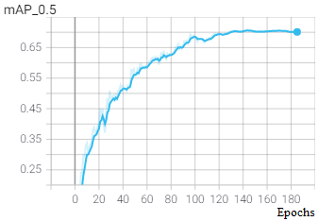
Validation accuracy
600 validation images
70% mAP accuracy

Slide 22
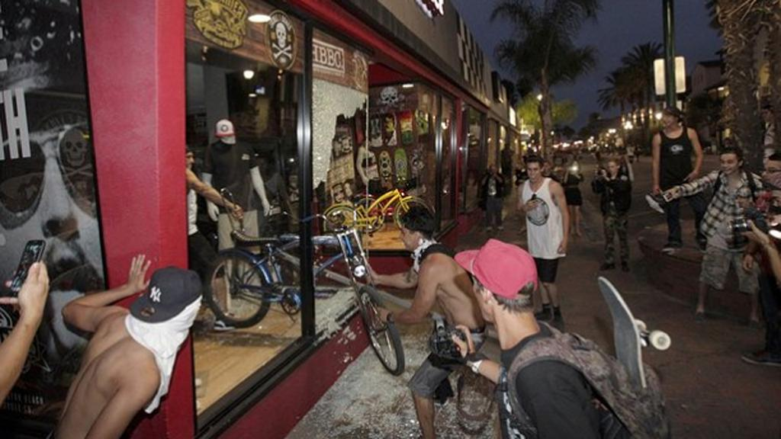

Faces dataset
WIDER FACE
Detection
Benchmarking dataset
Wide variety of images
Subsets by difficulty: easy, medium and hard.
Size:
32 203 images
393 703 labeled faces

Slide 23
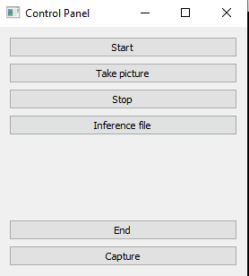
User interface

Slide 24
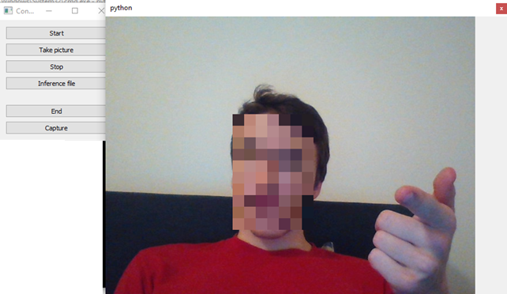
Start

Slide 25
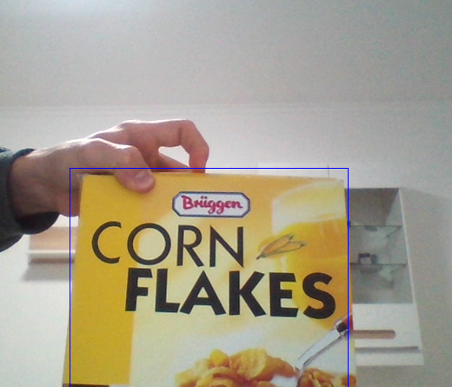
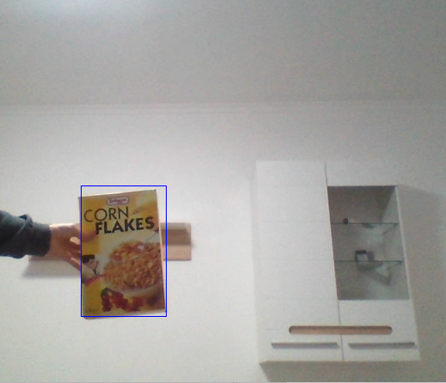
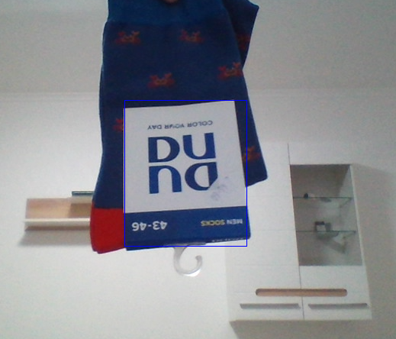
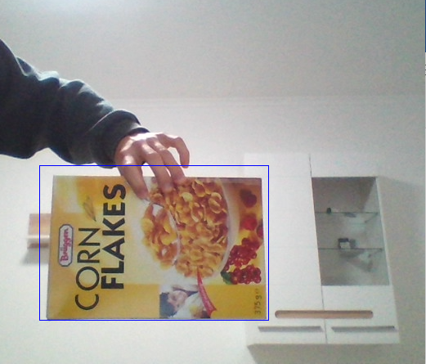
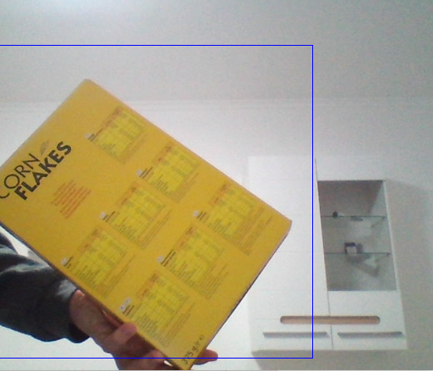
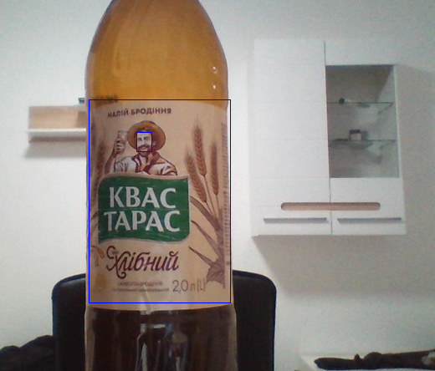
Evaluation (Advertising)

Slide 26
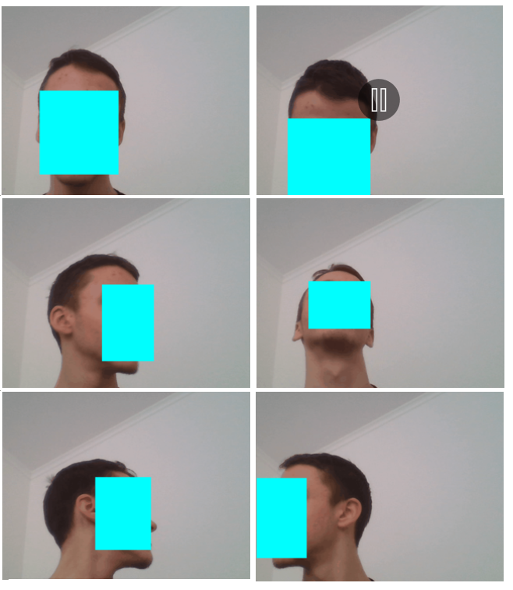
Evaluation (Face)

Slide 27
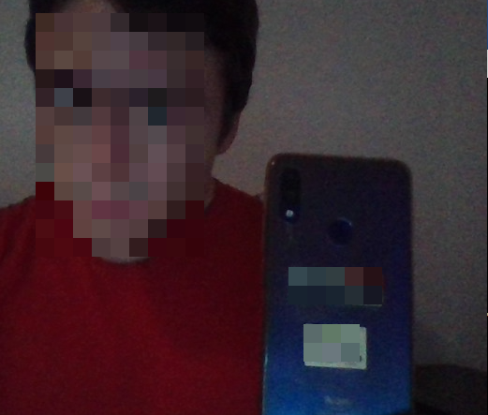
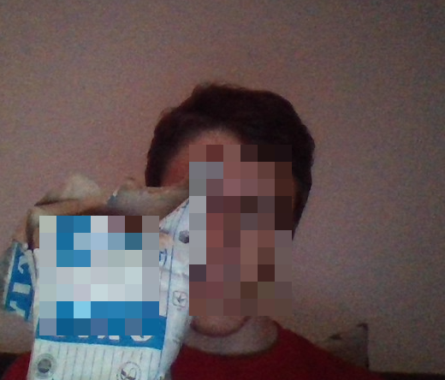
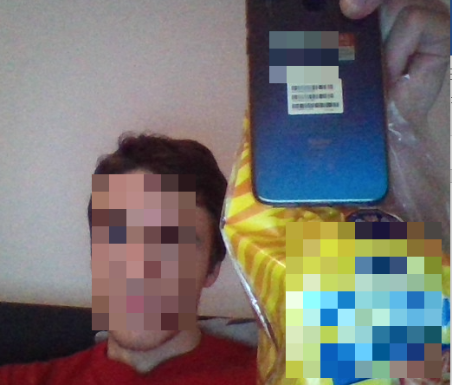
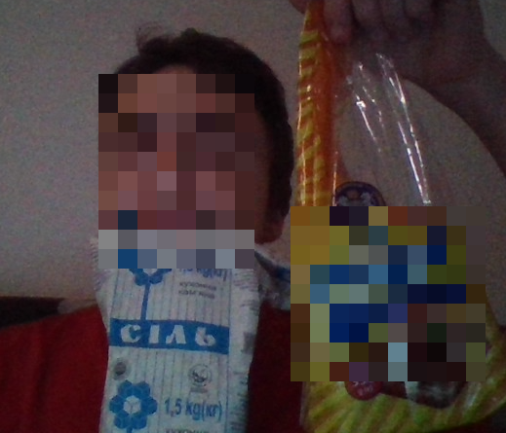
Evaluation (Advertising+Faces)

Slide 28
Conclusions
Set the requirements for software.
Analyzed real-time object detection methods. Found two optimal variants: YOLO+MTCNN and unified YOLO.
Described YOLO and MTCNN methods in detail.
Trained ads detector. Validation accuracy: 70% mAP.
Used pre-trained MTCNN and trained YOLO models to make a desktop application to process webcam stream at 24 fps.
In the future can try adding tracking algorithms for better stream speed and smoothness.

Slide 29
References
Redmon, J., Divvala, S., Girshick, R., & Farhadi, A. You Only Look Once: Unified, Real-Time Object Detection. IEEE Conference on Computer Vision and Pattern Recognition (CVPR). doi:10.1109/cvpr.2016.91, 2016.
Redmon, J., & Farhadi, A. YOLO9000: Better, Faster, Stronger. IEEE Conference on Computer Vision and Pattern Recognition (CVPR). doi:10.1109/cvpr.2017.690 , 2016.
YOLOv3: An Incremental Improvement. arXiv:1804.02767, 2018.
Chen, W., Huang, H., Peng, S., Zhou, C., & Zhang, C. YOLO-face: a real-time face detector. The Visual Computer. doi:10.1007/s00371-020-01831-7, 2020.
Zhang, K., Zhang, Z., Li, Z., & Qiao, Y. Joint Face Detection and Alignment using Multi-task Cascaded Convolutional Networks. In IEEE Signal Processing Letters, 23(10), 1499–1503 doi: 10.1109/LSP.2016.2603342, 2016.
Yang, S., Luo, P., Loy, C. C., & Tang, X. WIDER FACE: A Face Detection Benchmark. IEEE Conference on Computer Vision and Pattern Recognition (CVPR). WIDER FACE: A Face Detection Benchmark. doi:10.1109/cvpr.2016.596, 2016.
YOLACT: Real-time Instance Segmentation. arXiv:1904.02689, 2019.
Mask R-CNN. arXiv:1703.06870, 2018.
Yinda Xu, Zeyu Wang, Zuoxin Li, Ye Yuan, Gang Yu. SiamFC++: Towards Robust and Accurate Visual Tracking with Target Estimation Guidelines. Conference on Artificial Intelligence (AAAI-20), 10.1609/aaai.v34i07.6944, 2020

Slide 30
Yang, J.; Yang, G. Modified Convolutional Neural Network Based on Dropout and the Stochastic Gradient Descent Optimizer. Algorithms 2018, 11, 28. https://doi.org/10.3390/a11030028
Zhong, Z., Zheng, L., Kang, G., Li, S., & Yang, Y. (2020). Random Erasing Data Augmentation. Proceedings of the AAAI Conference on Artificial Intelligence, 34(07), 13001–13008. doi:10.1609/aaai.v34i07.7000
Singh, K. K., & Lee, Y. J. (2017). Hide-and-Seek: Forcing a Network to be Meticulous for Weakly-Supervised Object and Action Localization. 2017 IEEE International Conference on Computer Vision (ICCV). doi:10.1109/iccv.2017.381
Sangdoo Y., Dongyoon H., Seong J. O. (2019) CutMix: Regularization Strategy to Train Strong Classifiers with Localizable Features. 2019 IEEE/CVF International Conference on Computer Vision (ICCV) doi:10.1109/iccv.2019.00612
A. Bochkovskiy, C.-Y. Wang, and H.-Y. M. Liao, “Yolov4: Optimal speed and accuracy of object detection,” arXiv preprint arXiv:2004.10934, 2020
Pengguang Chen. GridMask data augmentation. arXiv preprint arXiv:2001.04086, 2020.

Slide 31
Other references
Erik-Linder Noren, PyTorch YOLOv3, (2018), Github repository.
https://github.com/eriklindernoren/PyTorch-YOLOv3
2. Tim Esler, Face Recognition using PyTorch, (2020), Github repository.
https://github.com/timesler/facenet-pytorch
3. Ads dataset.
http://www.cs.ucf.edu/~aroshan/index_files/Dataset_PitOrlManh/zipped%20images/part1.zip
Annotations:
WannaFly, Mask_AD, Github repository.
https://github.com/WannaFIy/mask_AD/releases/download/AD/regions.csv

Slide 32
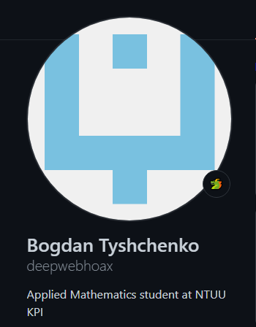

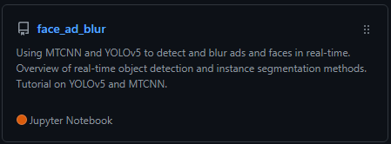
Code repository
Github: https://github.com/deepwebhoax/face_ad_blur

Slide 33


